Slide 1


Database Management System (BCSC-0003)
Topic: Introduction to DBMS
Nikhil Govil
Assistant Professor, Dept. of CEA, GLA University, Mathura.

Slide 2

Content
Difference between Schema and Instance in DBMS
Data Independence
Database Models
DBMS Vs RDBMS

Slide 3
Difference between Schema and Instance in DBMS

Slide 4
Difference between Schema and Instance in DBMS
Instances:
Instances are the collection of information stored at a particular moment.
The instances can be changed by certain CRUD (Create, Read, Update, Delete) operations as like addition, deletion of data.
Example –
Let’s say a table TEACHER in our database whose name is SCHOOL, suppose the table has 50 records so the instance of the database has 50 records for now and tomorrow we are going to add another fifty records so tomorrow the instance have total 100 records. This is called an instance.

Slide 5
Difference between Schema and Instance in DBMS
Schema :
Schema is the overall description of the database.
The basic structure of how the data will be stored in the database is called schema.
Example –
Let’s say a table named TEACHER in our database name SCHOOL, the TEACHER table require the name, dob, doj in the table so we design a structure as :
TEACHER
name: varchar doj: date dob: date
Above given is the schema of the table TEACHER.

Slide 6
Data Independence

Slide 7
Data Independence
Data independence can be explained using the three-schema architecture.
Data independence refers characteristic of being able to modify the schema at one level of the database system without altering the schema at the next higher level.
There are two types of data independence:
(1) Logical Data Independence and
(2) Physical Data Independence

Slide 8
Data Independence
Logical Data Independence:
Logical data independence refers characteristic of being able to change the conceptual schema without having to change the external schema.
Logical data independence is used to separate the external level from the conceptual view.
If we do any changes in the conceptual view of the data, then the user view of the data would not be affected.
Logical data independence occurs at the user interface level.

Slide 9
Data Independence
Physical Data Independence:
Physical data independence can be defined as the capacity to change the internal schema without having to change the conceptual schema.
If we do any changes in the storage size of the database system server, then the conceptual structure of the database will not be affected.
Physical data independence is used to separate conceptual levels from the internal levels.
Physical data independence occurs at the logical interface level.

Slide 10
Database Models

Slide 11
Database Models
Data Model gives us an idea that how the final system will look like after its complete implementation.
It defines the data elements and the relationships between the data elements.
Data Models are used to show how data is stored, connected, accessed and updated in the DBMS.
Some of the Data Models in DBMS are:
Hierarchical Model, Network Model, Entity-Relationship Model, Relational Model, Flat Data Model, Object-Oriented Data Model,
Context Data Model, Associative Data Model,
Object-Relational Data Model, Semi-Structured Data Model etc.

Slide 12
Database Models
Hierarchical Model:
Hierarchical Model was the first DBMS model.
This model organizes the data in the hierarchical tree structure.
The hierarchy starts from the root which has root data and then it expands in the form of a tree adding child node to the parent node.
This model easily represents some of the real-world relationships like hierarchy of any organization, sitemap of a website etc.

Slide 13
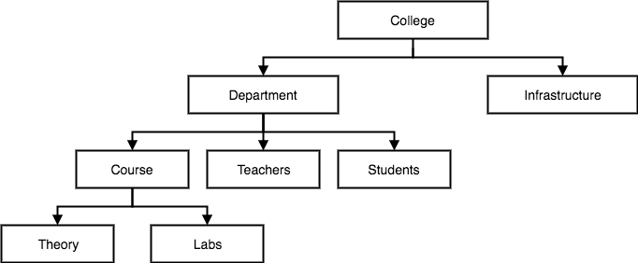
Database Models
Example:

Slide 14
Database Models
Network Model
This model is an extension of the hierarchical model.
It was the most popular model before the relational model.
This model is the same as the hierarchical model, the only difference is that a record can have more than one parent.
It replaces the hierarchical tree with a graph.

Slide 15
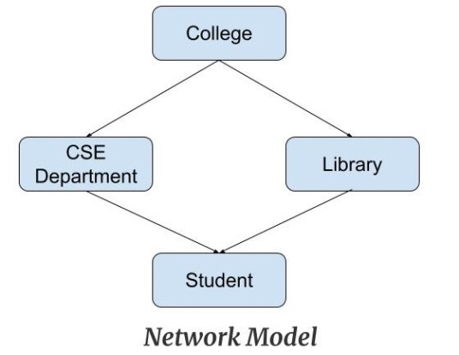
Database Models
Example: In the example below we can see that node student has two parents i.e. CSE Department and Library. This was earlier not possible in the hierarchical model.

Slide 16
Database Models
Entity-Relationship Model
Entity-Relationship Model or simply ER Model is a high-level data model diagram.
In this model, we represent the real-world problem in the pictorial form to make it easy for the stakeholders to understand.
It is also very easy for the developers to understand the system by just looking at the ER diagram.
We use the ER diagram as a visual tool to represent an ER Model.
ER diagram has the following three components: Entity, Attribute and Relationship.

Slide 17
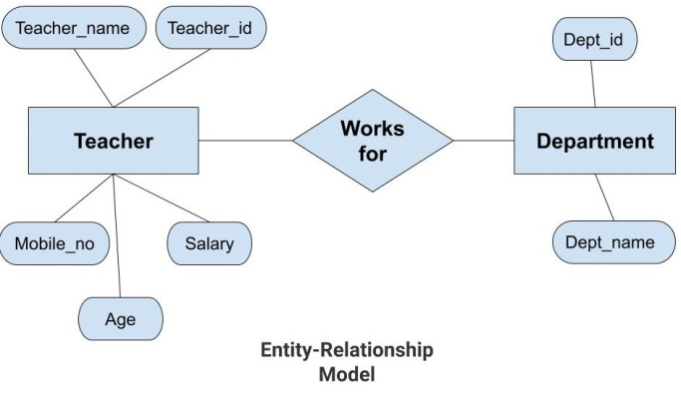
Database Models

Slide 18
Database Models
Relational Model
This model was introduced by Dr. E. F. Codd in 1970.
Relational Model is the most widely used model.
In this model, the data is maintained in the form of a two-dimensional table.
All the information is stored in the form of rows and columns.
The basic structure of a relational model is tables.
So, the tables are also called relations in the relational model.

Slide 19
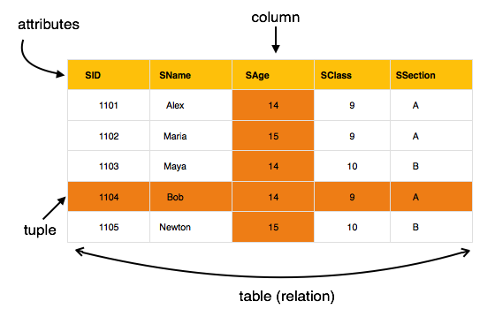
Database Models

Slide 20
DBMS Vs RDBMS

Slide 21
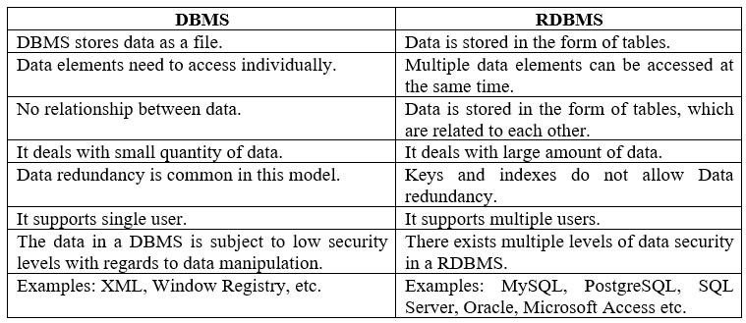
DBMS Vs RDBMS
The below table demonstrates the main difference between RDBMS and DBMS:

Slide 22
References
Korth, Silbertz and Sudarshan (1998), “Database Concepts”, 5th Edition, TMH.
Elmasri and Navathe (2010), “Fundamentals of Database Systems”, 6th Edition, Addision Wesley.
Date C J,” An Introduction to Database Systems”, 8th Edition, Addision Wesley.
M. Tamer Oezsu, Patrick Valduriez (2011). “Principles of Distributed Database Systems”, 2nd Edition, Prentice Hall.
https://www.geeksforgeeks.org/difference-between-schema-and-instance-in-dbms/last accessed on 10 December 2021.
https://www.javatpoint.com/dbms-data-independence/last accessed on 10 December 2021.

Slide 23


